Slide 1
6MARK017W Digital Marketing, Social Media and Web Analytics
Week 7 – web analytics
Dr Vassiliki Bouki
boukiv@wmin.ac.uk

Slide 2
Web Analytics
‘If you can’t measure it, it’s not worth doing it’
(but ‘not everything that can be measured, matters’)
“Web analytics is the measurement, collection, analysis and reporting of internet data for purposes of understanding and optimizing web usage.” (http://en.wikipedia.org/wiki/Web_analytics)
Web analytics is NOT just a tool that measures the traffic in your site – it is a powerful marketing tool.
‘Everything you would like to know about your site’s performance’

Slide 3
Web Analytics – why?
What to expect from ‘web analytics’?
User’s experience
Design
Existing business plan / actions
ROI (Return of Investment)
Future business plans

Slide 4

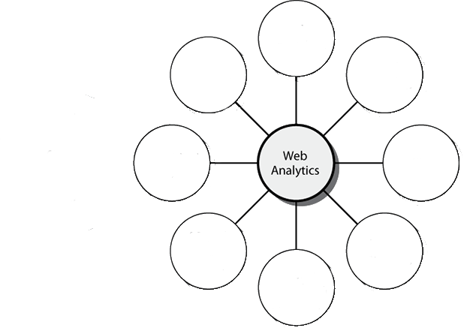
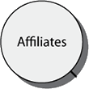

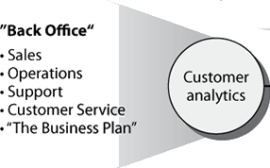
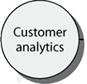




Web Analytics – where it fits
Figure 1-6: Where web analytics fits in an organization
Advanced Web Metrics with Google Analytics

Slide 5
Web Analytics – how?
Off-site web analytics tools: measure factors that are ‘outside’ your web site e.g. the potential of your site; buzz (comments) on the internet about your site / subject; potential audience etc.
In general they are tools that allow you to see the bigger picture of how your website compares with others
On-site web analytics tools: measure the actual traffic and visitors’ behaviour on your website e.g. interaction, engagement etc.
Do not forget on-site tools tell you how users behave – not why they behave like that.
Offsite and onsite analytics should be used to complement each other, not compete against each other.
Historically, web analytics has referred to on-site visitor measurement.

Slide 6




Web Analytics – how?
Where could we collect information?
A web site lives in the server
The server maintains files (logfiles) about the activity of the site.
When a user visits a page user’s browser makes a request to the server.
It is possible to collect data via the visitor’s web browser and send information to remote data-collection servers.
TAGS
Web Developer

Slide 7
Log files
Log files contain data collected by your web server and are independent of a visitor’s browser.
A web server logs its activity to a text file that is usually local: on the same network or even the same machine as your web server.
This technique, known as server-side data collection, captures all requests made to your web server, including pages, images, and PDFs, and is most frequently used by stand-alone licensed software vendors.

Slide 8
Problems with log files
Dynamically Assigned IP Addresses
Generally, a logfile solution tracks visitor sessions by attributing all hits from the same IP address and web browser signature to one person. Problem: when Internet Service Providers assign different IP addresses throughout the session. A US-based study showed that a typical home PC averages 10.5 different IP addresses per month. Those visits will be counted as 10 unique visitors by a logfile analyzer. Possible solution: use of cookies.
Client-Side Cached Pages
Client-side caching means a previously visited page is stored on a visitor’s computer. In this case, visiting the same page again results in that page being served locally from the visitor’s computer, and therefore the visit is not recorded at the web server.
Counting Robots
Robots (e.g. Spiders) visit the site & they can make up a significant proportion of the site traffic. Several robots (apart from spiders) exist: robots that check server performance; robots used for page scraping e.g. price comparison, competitive research etc. Logfiles will show all data for robot activity on your website, even though robots are not real visitors. Difficult to identify robots.

Slide 9
Page Tags
Page tags collect data via the visitor’s web browser and send information to remote data-collection servers.
This information is usually captured by JavaScript code (known as tags or beacons) placed on each page of your site.
This technique is known as client-side data collection and is used mostly by outsourced – Software as a Service (SaaS) vendor solutions.
Google Analytics is a Software as a Service (SaaS) page tag service.

Slide 10
Page Tags
Page tag solutions track visitors by using cookies.
Cookies: small text files that a web server transmits to a web browser so that it can keep track of the user’s activity. The visitor’s browser stores the cookie information on the local hard drive as name/value pairs.
For web analytics, the main purpose of cookies is to identify users for later use—most often with an anonymous visitor ID.
Among many things, cookies can be used to determine how many first-time or repeat visitors a site has received, how many times a visitor returns each period, and how much time passes between visits. The following are some cookie facts:

Slide 11
Page Tags
There are two types of cookies: first party and third party.
A first-party cookie is one created by the website domain. A visitor requests it directly by typing the URL into their browser or by following a link.
A third-party cookie is one that operates in the background and is usually associated with advertisements or embedded content that is delivered by a third-party domain not directly requested by the visitor.
For first-party cookies, only the website domain setting the cookie information can retrieve the data. This is a security feature built into all web browsers.
For third-party cookies, the website domain setting the cookie can also list other domains allowed to view this information. The user is not involved in the transfer of third-party cookie information and is usually not even aware that this is happening. Security issues.
A maximum of 50 cookies are allowed per domain for the latest versions of Internet Explorer and Firefox. Other browsers may vary (Opera 10 currently has a limit of 30; Safari and Google Chrome have no limit on the number of cookies per domain).
For more information see: https://developers.google.com/analytics/devguides/collection/analyticsjs/cookie-usage

Slide 12
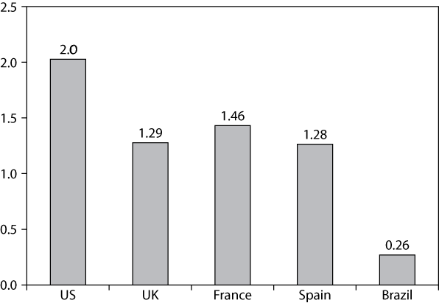
Problems with page tags
Missing tags
Set up tags
Java is not activated
Mobile devices (in relation to Javascript)
Firewalls
Deleting / resetting cookies
Percentage of Internet users with JavaScript-disabled browsers
From: ‘Advanced Web metrics with Google Analytics’

Slide 13
Other approaches
Hybrid methods
Some companies produce solutions that collect data through both logfiles and page tagging and can analyze both kinds. By using a hybrid method, they aim to produce more accurate statistics than either method on its own.
Click analytics
Click analytics is a special type of web analytics that gives special attention to clicks.

Slide 14
Data misinterpretation
Unique visitors + Unique visitors unequal to total unique visitors
New visitors + Repeat visitors unequal to total visitors
‘The hotel problem’
 | Day 1 | Day 2 | Day 3 | Total Unique visitors
Room 1
Room 2
Total visitors
Mary
Mary
Peter
2
Peter
John
John
2
2
2
2
3
???

Slide 15
Data misinterpretation
The above problem appears when we consider data for long and / or short period of time.
Page views and visitors
‘the shared computer ‘ & ‘one person uses more than one machine’

Slide 16
Improve accuracy in WA
Select a tool that uses page tagging and first-party cookies for data collection.
Use asynchronous page tagging with the code located in the head section of your pages.
Remove or report separately all nonhuman activity from your data reports, such as robots and server-performance monitors. Google Analytics ignores robots that do not execute JavaScript.
Track everything.
Regularly audit your website for page tag completeness .
Avoid making judgments on data that is less than 24 hours old.
For more recommendations see ‘Advanced Web Metrics with Google Analytics’ – chapter 2.

Slide 17
Privacy
There are two types of private information:
Non–personally identifiable information (non-PII): anonymous aggregate data that cannot be used to identify or deduce demographic information, such as name or address.
Personally identifiable information (PII): data can be used to identify personal information such as name or address.
Since 2011 you have to request explicit consent from your visitors if you collect PII by the Law.
https://ico.org.uk/for-organisations/guide-to-pecr/cookies-and-similar-technologies/
https://ico.org.uk/media/for-organisations/documents/1545/cookies_guidance.pdf (copy and paste the link to open PDF; it does not work well by clicking)
By default GA does NOT collect PII.
It depends how you set up the tags / cookies. Be really careful; follow changes; respect legal obligations. Always check for any legal changes.

Slide 18
Web Analytics & Google Analytics
There are several companies as well as free tools that can be used for Web Analytics
Google Analytics (GA) is a free, convenient and powerful tool to track important information of your website offered by Google.
Most web analytics tools gather similar information (at least at the basic level). Main differences: the amount of data gathered; free or not; how reports are presented.
GA limitations:
Data Limits: Standard (free) account limit is 10 million hits per month; Premium account is 1 billion hits per month. Premium Service Pricing - $150,000 annual flat fee – there are cheaper options.
Data Collection & Reporting Delays: Google shows real time data of site visitors, referral websites, and geographical data. The collection and reporting system has a delay of 24 hours for Standard users and 4 hours for Premium users for data such as conversions.
Interface and Language
Several alternatives to GA

Slide 19
Google Analytics – Introduction
By default GA collects information that provides a complete picture of your visitor activity by tracking all possible visitor experience ➔ not enough!
There are other data that are NOT collected by default, such as:
File downloads
Links that go to third-party websites, such as partners, affiliates, trade associations etc.
In-page events that do not generate a page view, such as clicking an Add To Cart button.
YouTube embedded videos
Visitor types (e.g. Members, subscribers etc)
Segmenting visitors (e.g. only social media visits, segments by geographic location etc).

Slide 20
Google Analytics Accounts
Google Account
→
Google Analytics Account
→
Properties
In order to use Google Analytics you must have a ‘Google account’.
Using your Google account create a ‘Google Analytics account’.
Do not confuse the ‘Google account’ with the ‘Google Analytics account’.
Each Google Analytics account can contain one or more properties.
A property could be a site / mobile application / domain for which you would like
to collect data.
In standard Google Analytics, you can set up 100 accounts and can add 50 properties
(for the time being think the property as a website) per account

Slide 21
Google Analytics Accounts
A GA Account is really just an organizational layer;
An account is a way to group web sites together and decide who has access to them.
Example 1:
If you are a web developer it is likely to have several clients. One client might have more that one web site.
Create a Google Analytics account for each client
Within the account of a client create one or more properties. Each property corresponds to a web site that belongs to this client
Within each property you can create several views
Example 2:
You create one account with many different properties.
All properties might be related to the same web site but focus on different parts e.g the main site, a blog, support centre, landing pages, etc.

Slide 22
Google Analytics Accounts
A Google Analytics Account has one or more properties.
Each property is associated with a unique tracking code (GATC) with its own unique ID for identifying data from that property.

Slide 23
Google Analytics Accounts
Universal Analytics and Google Analytics 4
Different tracking codes (GATC)
Universal Analytics is a version of Google Analytics. The format of Universal Analytics ID is: UA-XXXXXXXX
Google Analytics is the most recent version of Google Analytics. The format of Google Analytics 4 ID is: G-XXXXXXXX
Both versions are currently available.
We’ll examine close the Google Analytics 4 version. From time to time might make reference to Universal Analytics.
(https://support.google.com/analytics/answer/9964640?hl=en#zippy=%2Cin-this-article)

Slide 24
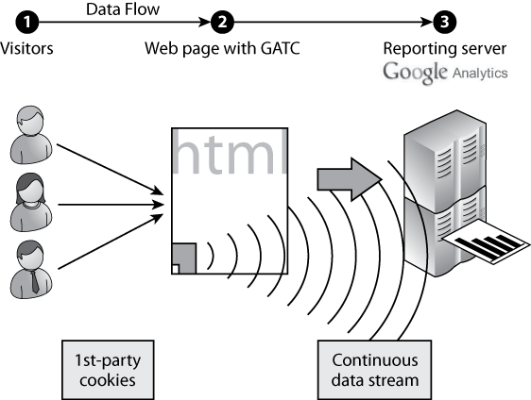
Google Analytics – Process
Page tag solution – first party cookies
When you create a property in a Google analytics account the GATC: Google Analytics Tracking Code is automatically generated.
You must include the code in your site.
When a visitor comes to a web page with GATC the cookie saves some information and reports are sent to server

Slide 25
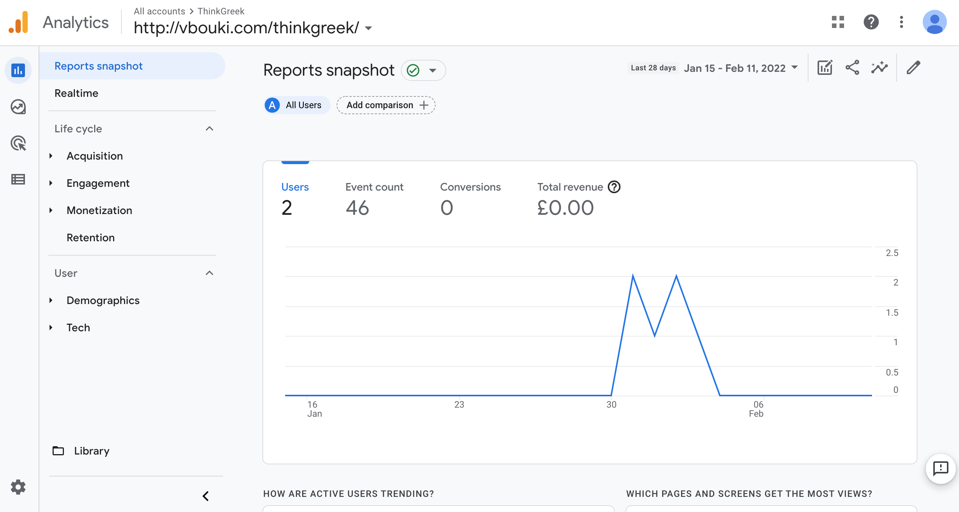
Google Analytics Home – Interface
Account info;
Tracking
Code;
Change account
User Details
Share reports
Customise reports
Insights
HOME information

Slide 26
Next week
This week, we:
Started with web analytics;
Discussed different methods to collect data (log files and page tags) and problems with each method;
Discussed misinterpretation of data and how to improve accuracy;
Talked about ‘privacy’
Introduction to Google Analytics explained the structure of a GA Account
Went through the Google Analytics interface
Next week we will go through the information we could collect with Google Analytics and the reports we can generate in details; we will discuss the terminology and we’ll see how to expand the reports.

